Slide 1


Kanak print-n-pack
C

Slide 2
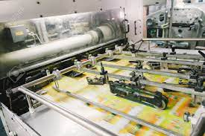
C
About us
Established in the year 1997, we “Kanak Print-N-Pack ” is one of the Leading Manufacturer and Dealer of a wide range of Paper, PVC & PP Products used in the packaging and value addition for your products
We are engaged in manufacturing, supplying, wholesaler, distributer, trading a wide assortment.
Printed Satin
Ribbon Roll
Rubber Silicon Label and Taffeta Labels
Printed Stickers, Paper Sticker.
Packaging like Clear PVC Bag, Soft PVC Pouches
Stitched Pvc bags
Thermocol sheets
Packaging Boxes
Rubber tags & Rubber keychain
Our valued clients can avail these products from us at reasonable rates. Ably led by “Mr. Mahendra Mehta” to outshine all competitors in all aspects.We have gained a remarkable and strong position in the market.

Slide 3
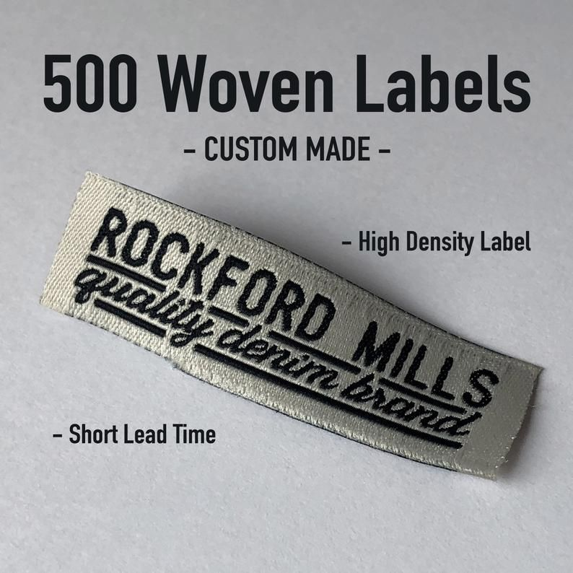
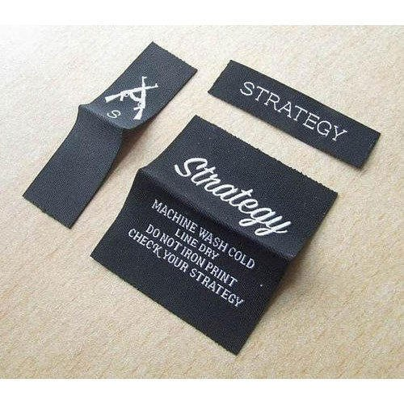
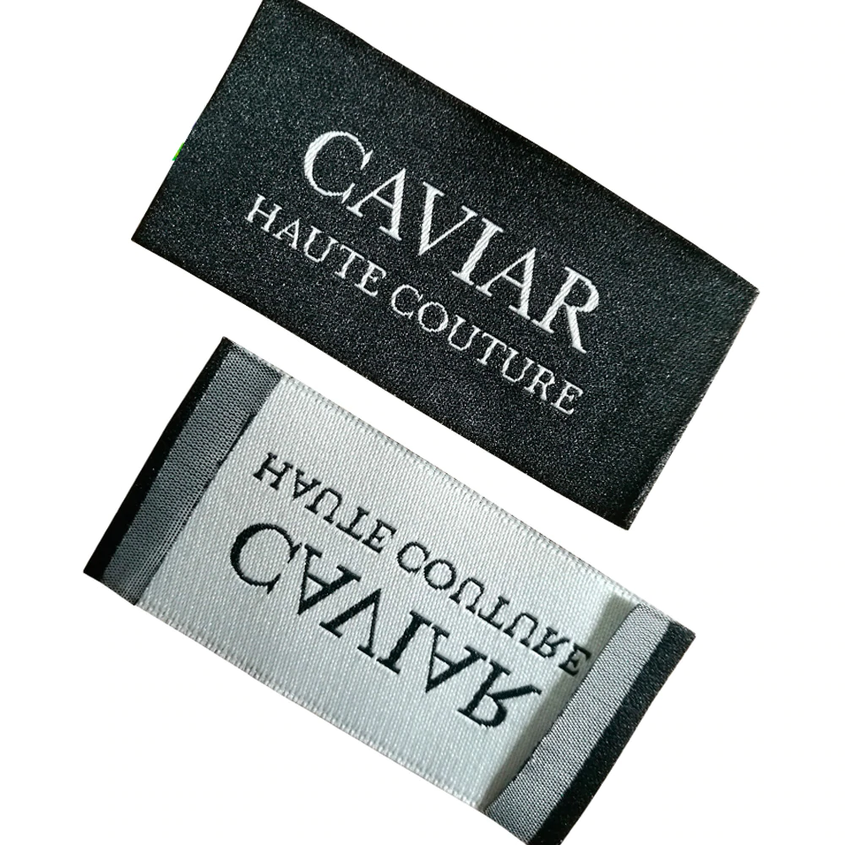
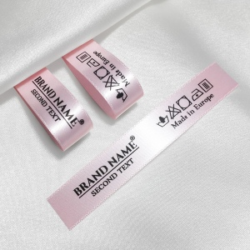
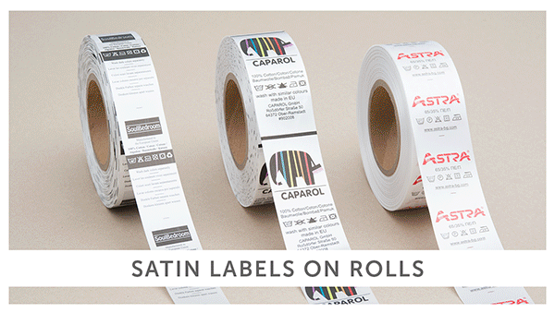
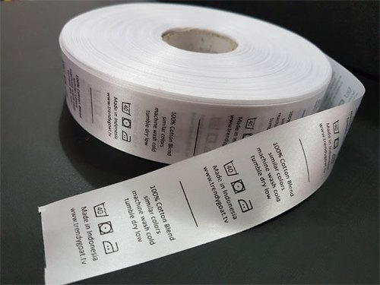
C
LABEL
Woven Label and Satin Label used in garment industry, hosiery industry, textile fabric industry for branding awareness. We produce a wide variety of labels with best grade material according to the defined guidelines of market.
Woven Label
Satin Label

Slide 4
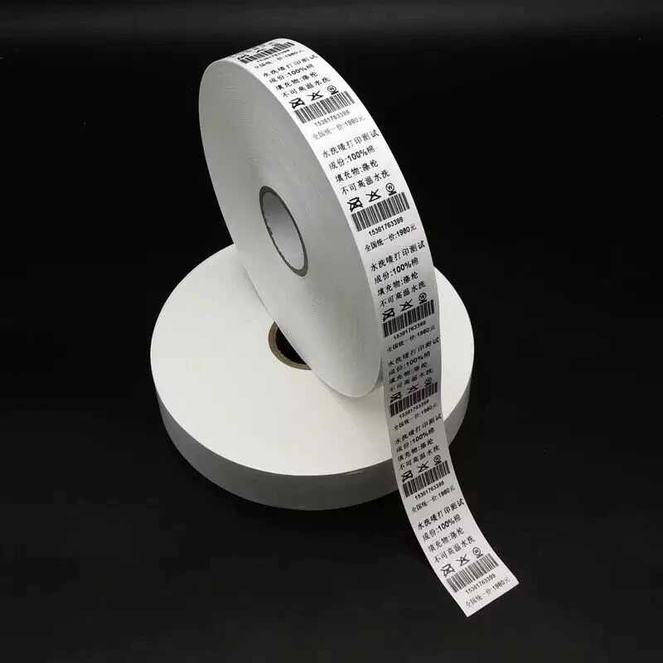
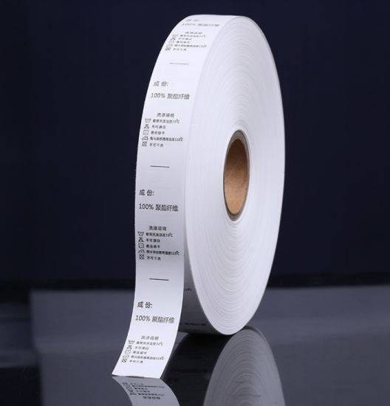
C
LABEL
Taffeta Label widely used in the textile & garment industry as a budget choice for care labels, brand labels, special instruction labels.
Usage/Application | Packaging
Usage/Application | Garments
Color | Multiple
Pattern | Printed
Application industry | Apparel and Textiles
Size | Different
Taffeta Label

Slide 5



C
Contact Us
Office : 9/11,Ladwadi,Shakti Sadan,3rd Floor, R N 20,Old Hanuman Lane,Kalbadevi Road, Nr Old Hanuman Lane, Mumbai-400002.
Mahendra Mehta 9322099267
Works: Unit No 106, 1st Floor, building no A6, Prerna Complex,Dapoda Road, Val Village, Bhiwandi 421302, Thane.
kanakprints1@gmail.com

